Slide 1
Linear search
Linear search is a very simple search algorithm. In this type of search, a sequential search is made over all items one by one. Every item is checked and if a match is found then that particular item is returned, otherwise the search continues till the end of the data collection

Slide 2
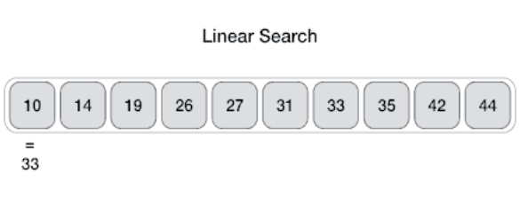
Linear search

Slide 3
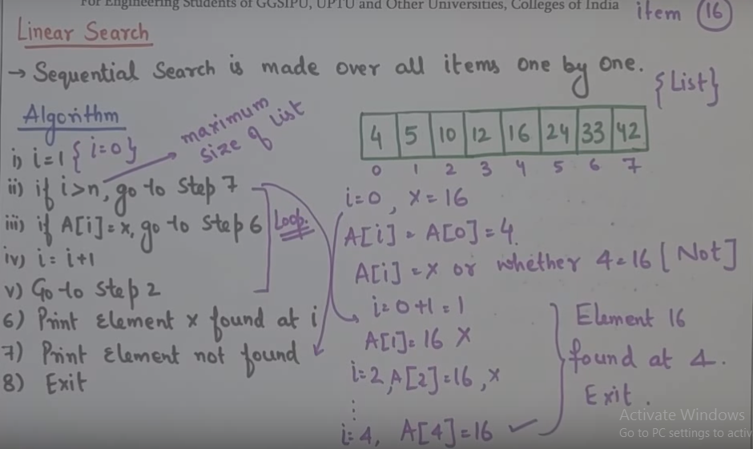

Slide 4
Binary search
Binary search is a fast search algorithm with run-time complexity of Ο(log n).
This search algorithm works on the principle of divide and conquer.
For this algorithm to work properly, the data collection should be in the sorted form.

Slide 5
Binary search looks for a particular item by comparing the middle most item of the collection.
If a match occurs, then the index of item is returned.
If the middle item is greater than the item, then the item is searched in the sub-array to the left of the middle item.
Otherwise, the item is searched for in the sub-array to the right of the middle item.
This process continues on the sub-array as well until the size of the subarray reduces to zero.

Slide 6
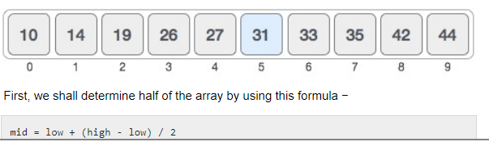

Slide 7
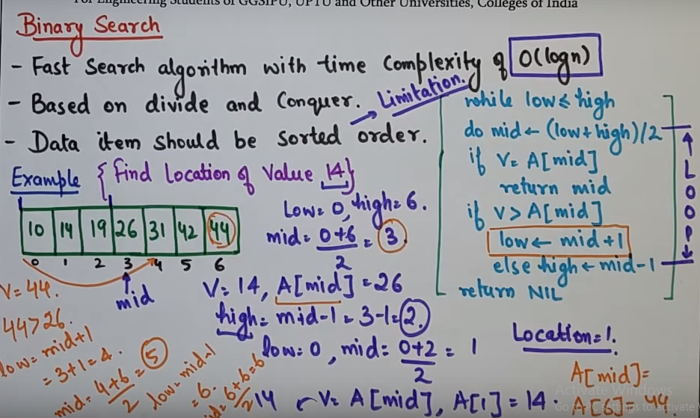

Slide 8
APPLICATIONS
The searching techniques are applicable to a number of places in today’s world, may it be Internet, search engines, on line enquiry, text pattern matching, finding a record from database, etc.
The most important application of searching is to track a particular record from a large file, efficiently and faster.

